Slide 1
Microservices Enabling Digital Experiences and Aggressive Go to Market
Nov 13, 2019

Slide 2
Introduction to Spring Boot
Expectation:
You should know java and Spring Annotation.
A basic understanding of developing web application .
Basic understanding of JPA is bonus not mandatory.
You are not expected to have nay experience in Eclipse, Maven or Tomcat.
Installing Tools
Eclipse & Embedded with Maven
Download Eclipse from Eclipse.org
Installing STS[Spring Tool Suite] on Eclipse.
PostMan/Swagger
-Creating a Microservice
-Testing.

Slide 3
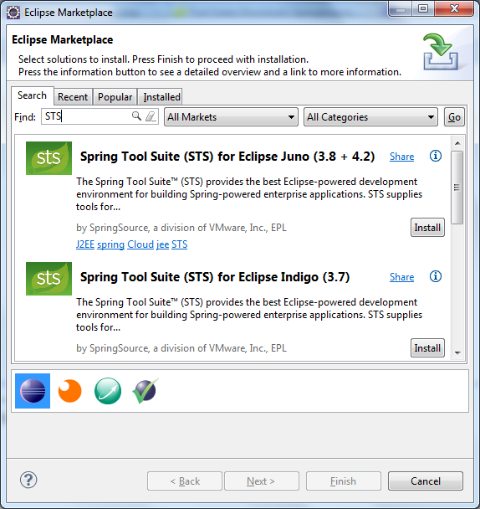
Installing STS
Click Help > Eclipse Marketplace… from Eclipse’s main menu. The Eclipse Marketplace dialog appears, type Spring Tool Suite or STS into the Find textfield and hit Enter. Eclipse will send query to its server and display results as shown below:

Slide 4
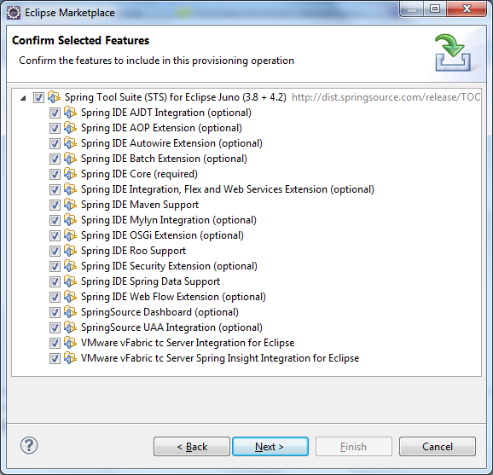
Select the version that matches your Eclipse’s version and click Install button. Here we select Spring Tool Suite (STS) for Eclipse Juno (3.8 + 4.2). It takes a while for Eclipse to fetch the details and show the features of STS as shown below:
:

Slide 5
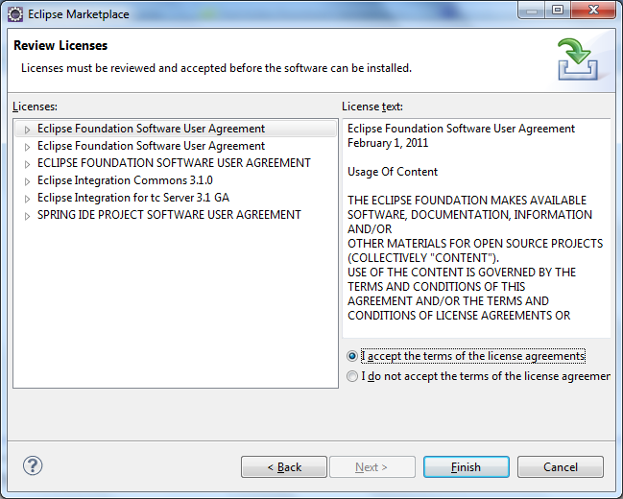
All features are selected by default, click Next. The Review Licensesscreen appears:

Slide 6
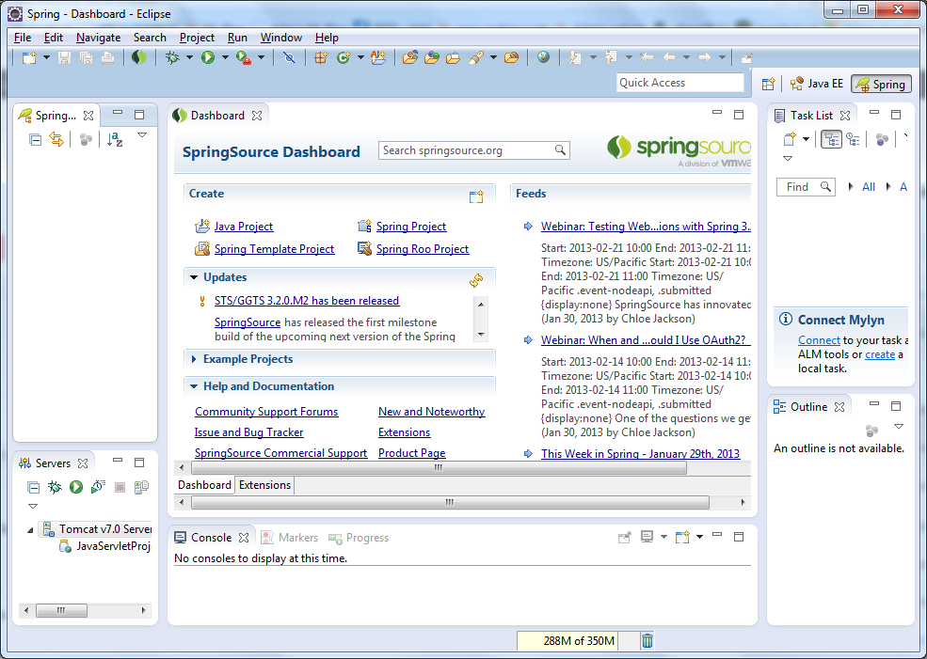
After STS installation:

Slide 7
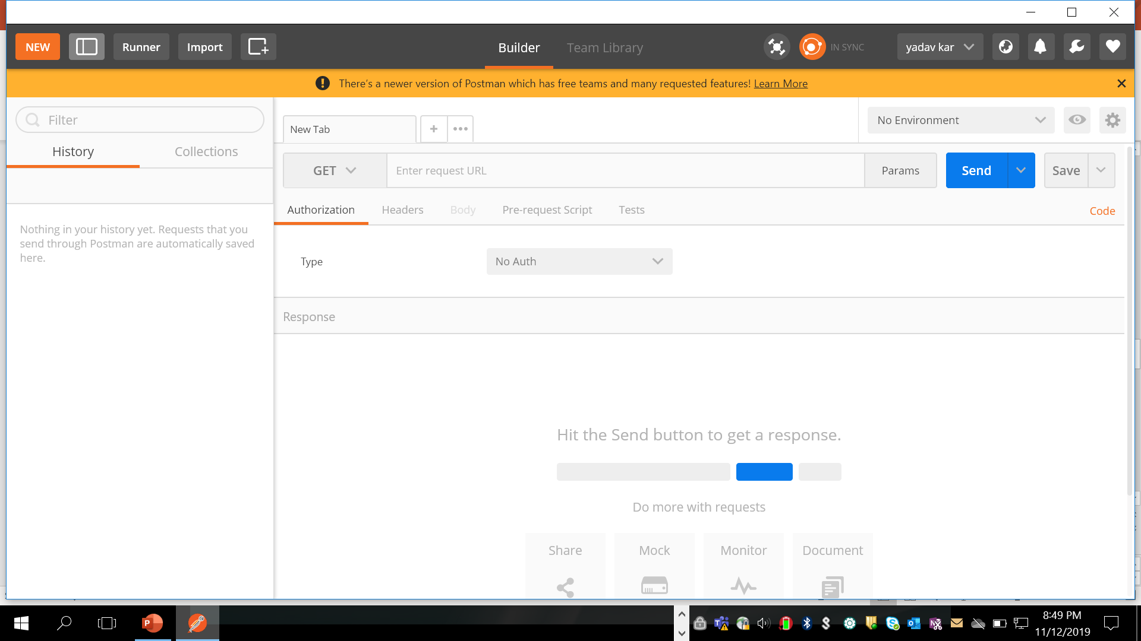
Adding POST Man to Chrome/IE
https://chrome.google.com/webstore/detail/postman/fhbjgbiflinjbdggehcddcbncdddomop?hl=en

Slide 8
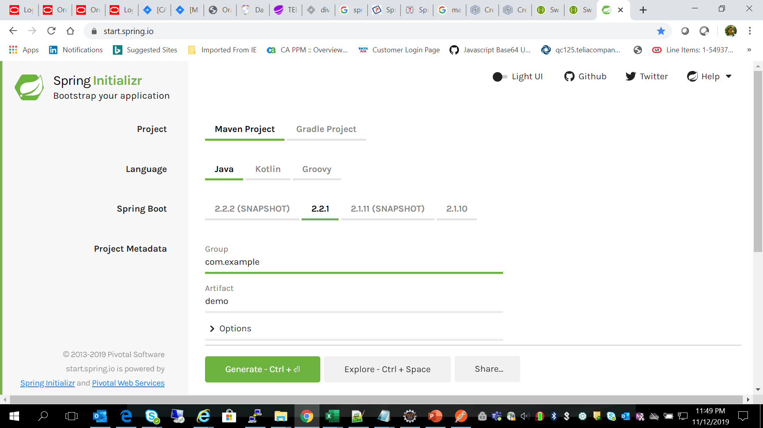
Create sample project from Spring site
https://start.spring.io/

Slide 9
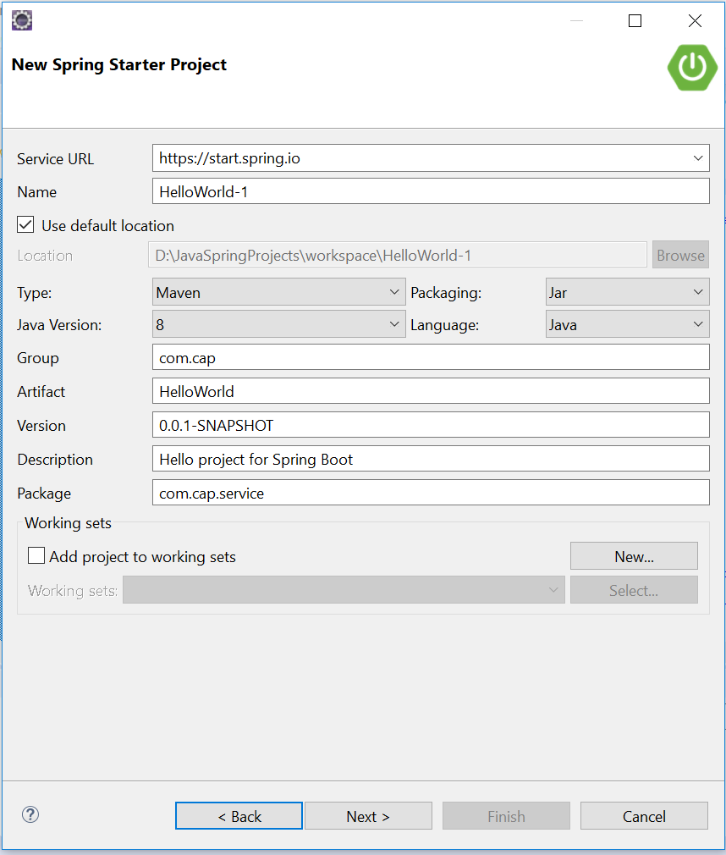
Creating HelloWorld Microservice

Slide 10
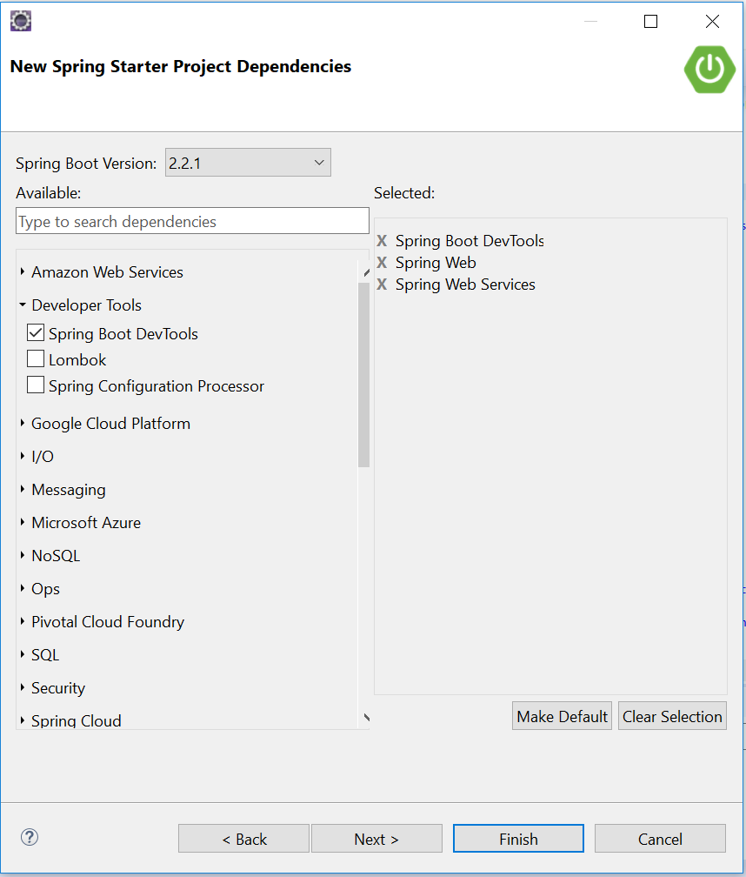
Adding Dependencies

Slide 11
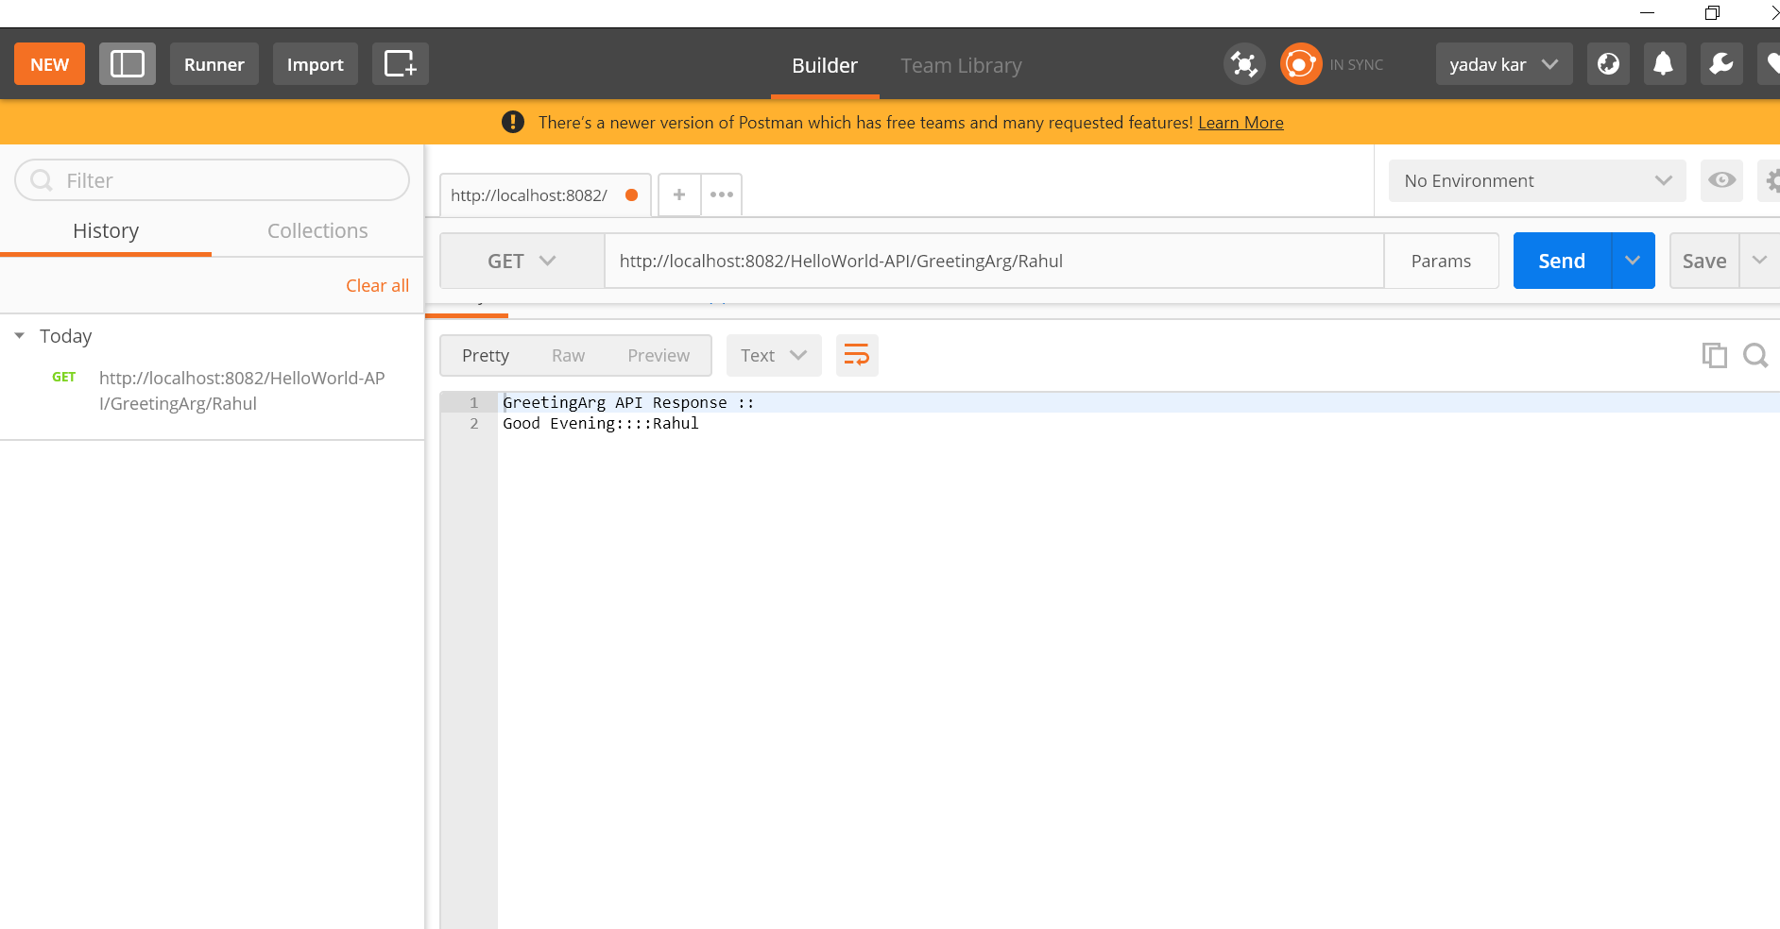
Testing with POSTMAN

Slide 12
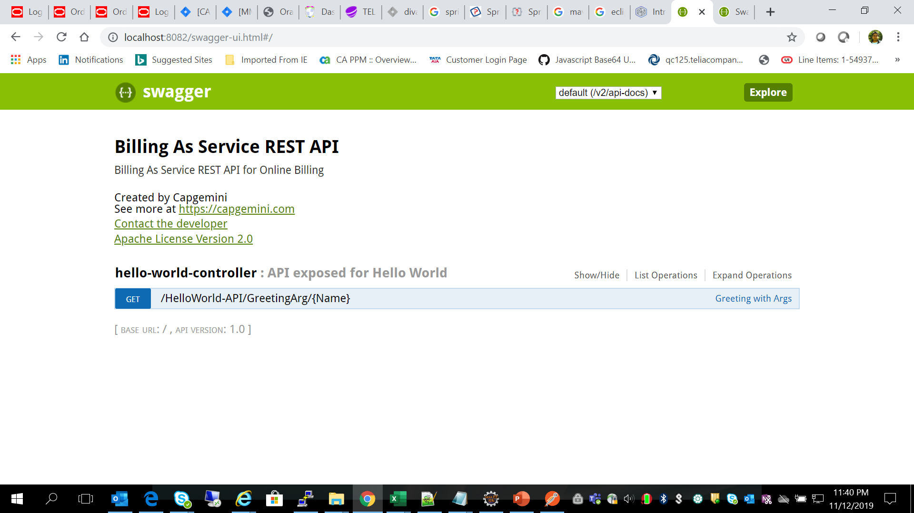
Testing with Swagger

